Slide 1
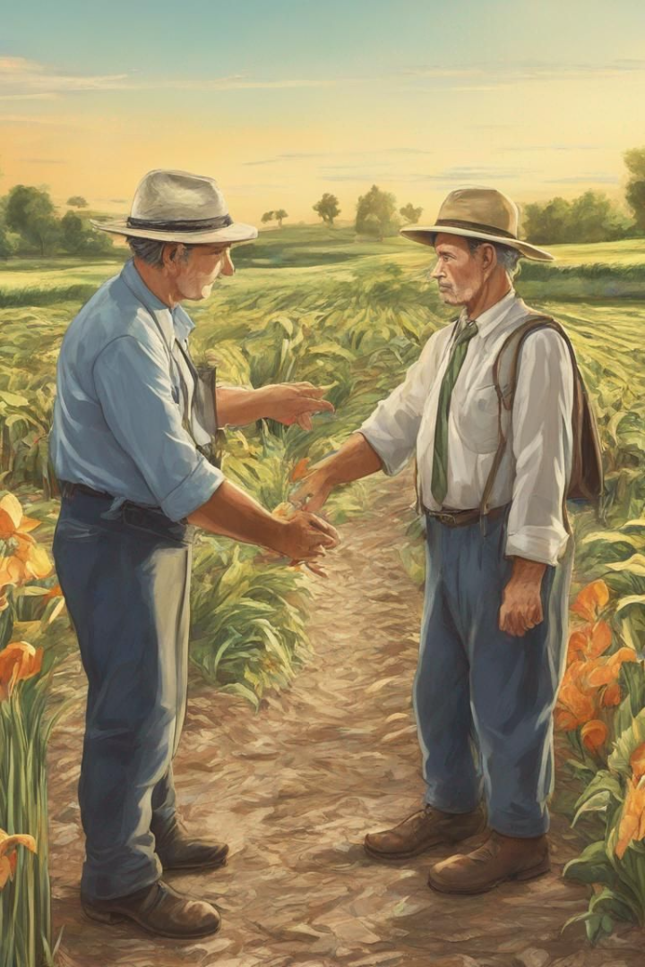
Agri Trade: Bridging Agriculture and Trading for Zero Hunger
In a world grappling with the persistent challenge of hunger, Agri Trade emerges as a transformative solution by seamlessly blending agriculture and trading.
TEAM: -Rohan -Thirumurugan -Kanimiozhi -Nithin

Slide 2

Introduction
Redefining Agriculture
Empowering Trade
Vision for Zero Hunger
Agri Trade's mission is to revolutionize agriculture by promoting sustainable practices that not only provide food security but also protect the environment and preserve natural resources.
By streamlining the trading process and ensuring fair compensation for farmers, Agri Trade aims to create a sustainable trading framework that benefits both producers and consumers.
Agri Trade envisions a world where every individual has access to nutritious food, and communities thrive through sustainable agricultural practices and equitable trading opportunities.

Slide 3
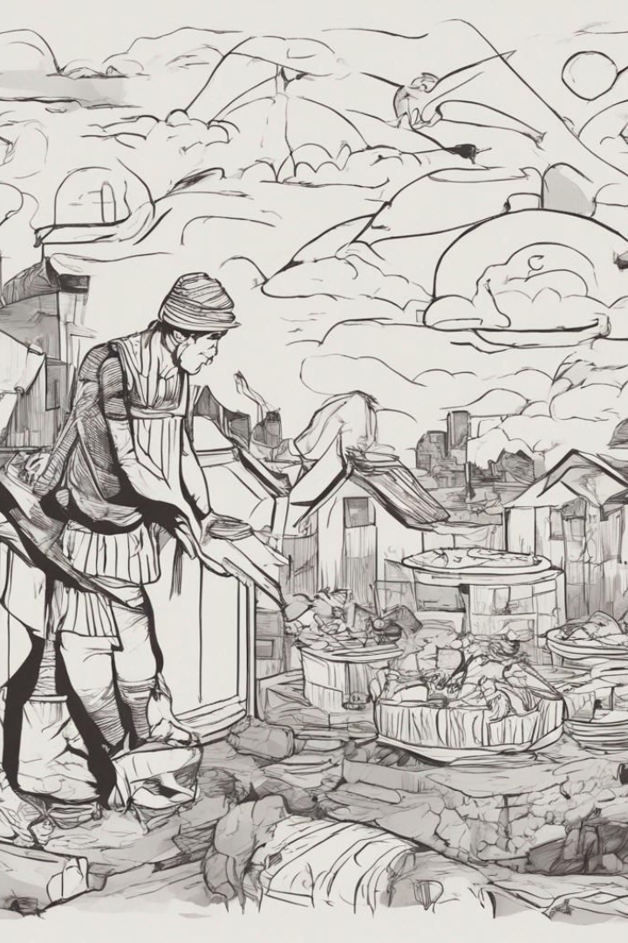
The problem of hunger
1
Global Impact
The issue of hunger affects millions worldwide, creating immense challenges and hindering the development of communities, especially in impoverished regions.
2
Social Consequences
Hunger not only impacts physical health but also undermines the social and economic fabric of communities, leading to long-term implications for future generations.
3
Urgency of Action
Understanding the urgency of addressing hunger is crucial for motivating collective action and promoting sustainable solutions to combat this critical issue.

Slide 4

The Agri Trade Concept
Combining Agriculture and Trading
Agri Trade combines agriculture and trading to cultivate crops and allow investors to participate in the process, fostering a symbiotic relationship between traditional agriculture and modern financial markets.
Real-time Virtual 3D Land Representation
Agri Trade uses a webapp to create a virtual 3D representation of farmland. This immersive experience allows investors to actively engage in cultivation activities and make informed decisions.
Digital Land Split into Shares
Agri Trade revolutionizes ownership by digitizing land and dividing it into virtual shares. Investors buy these shares, gaining a stake in agricultural land and establishing a direct connection to the cultivation process. This streamlined ownership model enhances investment accessibility while fostering investor involvement in real-world farming activities.

Slide 5

How It Works
Process from Investment to Cultivation: Investor's Role and Decision-making Power
The Agri Trade model follows a systematic process, starting with investor participation through financial investment. Investors, holding virtual shares, assume a pivotal role in decision-making regarding various farming stages. From determining the type of crops to be planted to making strategic decisions throughout the cultivation process, investors actively shape the trajectory of agricultural activities.
Steps of Farming Covered: Seeding, Watering, Maintenance, Harvest, etc.
Agri Trade comprehensively covers the entire farming lifecycle. Investors are involved in critical stages such as seeding, watering, maintenance, and harvesting. Each step is meticulously managed through the digital platform, ensuring that investor decisions directly impact the real-world cultivation process, creating a symbiotic relationship between virtual engagement and physical farming.
Real-time Management and Updates to Investors
One of the key features of Agri Trade is its commitment to real-time transparency. Investors receive continuous updates on the progress of farming activities, market conditions, and any external factors influencing their investment. This dynamic and responsive system empowers investors with the information needed to make informed decisions throughout the cultivation cycle.

Slide 6

The role of agriculture in addressing hunger
Sustainable Practices
Community Empowerment
Educational Initiatives
Agriculture plays a vital role in addressing hunger by implementing sustainable farming methods that ensure long-term food security and reduce environmental impact.
Investing in agricultural education and innovation is essential for developing solutions to hunger and equipping future generations with the knowledge to sustainably address food insecurity.
Agriculture serves as a cornerstone for community development, providing livelihoods, fostering self-sufficiency, and promoting economic stability.

Slide 7




The importance of trading in agricultural products
Market Accessibility
Facilitating the trading of agricultural products provides farmers with access to broader markets, creating opportunities for increased revenue and growth.
Consumer Reach
Efficient trading channels enable the distribution of high-quality agricultural products to consumers worldwide, ensuring food accessibility and nutritional diversity.
Economic Stimulation
Effective trading practices contribute to economic development, boosting the prosperity of farming communities and fostering sustainable agricultural practices.

Slide 8

Our mission and goals
Zero Hunger
Community Impact
Sustainability
Our mission is to actively contribute to the global effort to achieve Zero Hunger by promoting sustainable agriculture and equitable trading practices.
Empowering farming communities and ensuring food security for all is a core goal that drives the heart of Agri Trade's mission.
Upholding sustainable agricultural and trading practices is fundamental to our vision of creating long-lasting impact and resilience.

Slide 9

Our approach and strategies
Virtual 3D Land Ownership
Utilizing cutting-edge technology to enable virtual ownership of agricultural land, fostering shared responsibility and sustainable utilization.
Investor Engagement
Engaging with socially responsible investors to drive sustainable agricultural initiatives and promote ethical trading practices.
Community Empowerment
Developing programs to empower farming communities by providing access to resources, education, and market opportunities.

Slide 10
Objectives
Transforming Vision
Manifest the vision of sustainable agriculture and zero hunger into tangible initiatives and widespread impact.
Collaborative Action
Forge strong partnerships and alliances to collectively work towards addressing food insecurity and building resilient communities.
Empowering Change
Take proactive measures to empower farmers, support agricultural innovation, and create a sustainable trading ecosystem.

